Slide 1
Contact Center
Accounts Payable

Slide 2






Accounts Payable (AP) Contact Center & Main benefits
  The Accounts Payable Contact Center is a portal that allows you to easily contact the Accounts Payable team through webforms. In these forms we can choose the reason for the query and fill in the fields with the necessary information that the team needs to be able to resolve the request.
GB Vendors
AP Team
Main Benefits using AP Contact Center are:
Simple online access in GBfoods website
Faster response to your enquiries and claims
Visibility on the status of your enquiries and claims (traceability of tickets)
  Please note that this new tool is not replacing our current invoice reception channels, which remain the same.

Slide 3


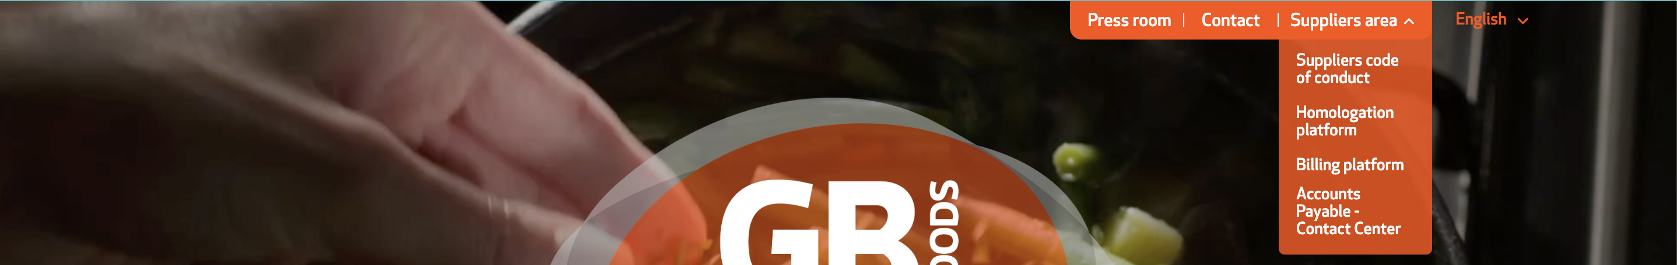

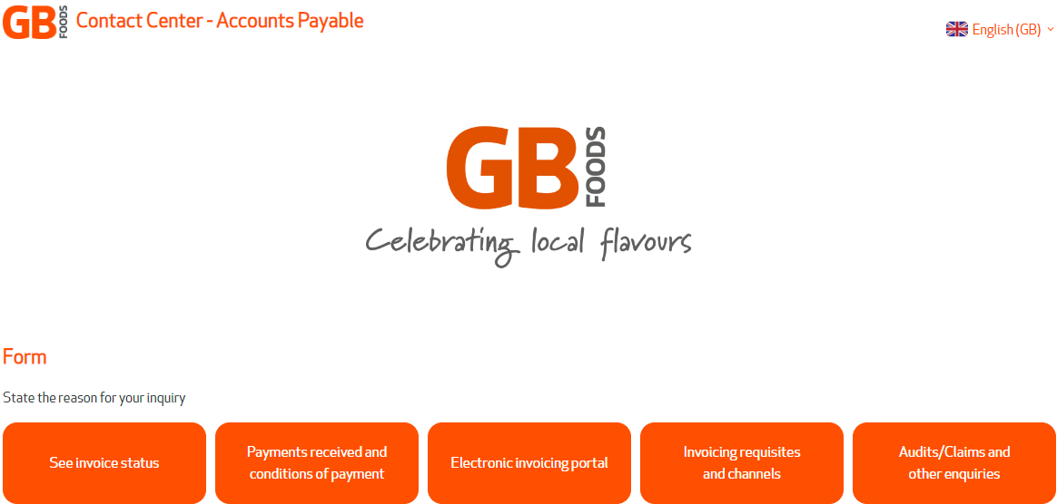
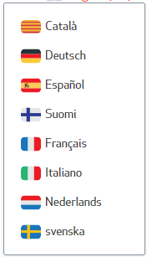
How to Access the Contact Center – Accounts Payable
The new Contact Center – Accounts Payable allows you to easily contact the AP team and get a quick resolution to your concern by following the instructions bellow:
Access through our website http://www.thegbfoods.com, select the Suppliers Area option in the top right menu and then select the new Accounts Payable – Contact Center option.
Direct Access Link:
https://ap-contactcenter.thegbfoods.com
Option to change the language of the form
Select the reason for your concern by clicking on one of the options in the form.
You can change the language from the icon marked in the image below.

Slide 4

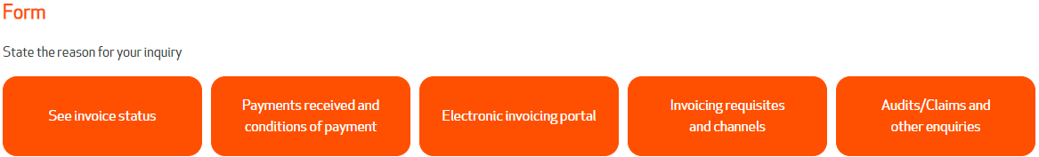
Which concern fits better for my case?
The following are some of the cases that best fit into each category
Why hasn’t my outstanding invoice been paid?
Which invoices will be paid in the next payment?
Have you received my invoice or invoice list attached?
I require a breakdown of a payment received
I need to make an enquiry about reverse factoring
I need to notify you of a new payment bank account
I need to confirm or change my conditions of payment
What methods of payment are available for my invoice?
How do I register my business on the Electronic invoicing portal?
The status displayed on the Electronic invoicing portal for my order to be invoiced is invoiced or closed.
Why is the status of my invoice blocked on the Electronic invoicing portal?
I have sent the wrong invoice to the Electronic invoicing portal and I would like to cancel it.
Assistance on the Electronic invoicing portal
How do I send my invoice to GBfoods?
What order number should I put on my invoice?
What tax or legal information should I put on my invoice issued to GBfoods?
Audit
Sending a formal letter to GBfoods
Assistance for the Jaggaer Platform
Assistance for the Contact Centre Platform

Slide 5

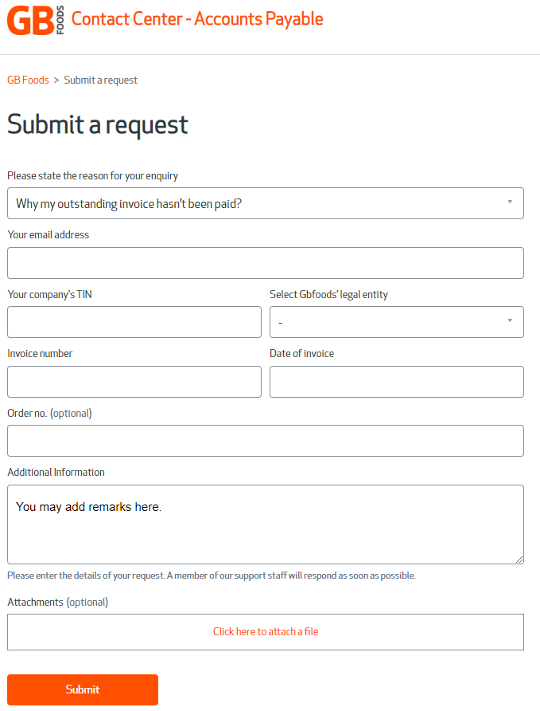
Request Submission
After selecting the reason for your request, the following form will be displayed:
A
Select the reason for your concern
B
Fill all the required fields (*)
C
Send your request through the Submit button

Slide 6
Thank You !
GBfoods Accounts Payable

