Slide 1
E-invoicing FAQs
Billing Platform

Slide 2
Click on your question
How do I register on the GBfoods Billing Platform?
What does “full company access” offer?
I don't remember my password or it's blocked
Where can I find the user guide?
What formats can I use to issue invoices?
How can I search for a purchase order on the website?
How can I bill a purchase order?
How can I bill additional shipping charges on my invoice?
How can I void an incorrect invoice on the platform?
How can I issue a partial invoice (%) for an order?
Can I issue an invoice with “Closed” status?
How can I see the status of my invoices?
How do I update my tax information on the platform?
How do I activate the notifications feature from the platform?
How do I issue invoices for logistics services?

Slide 3
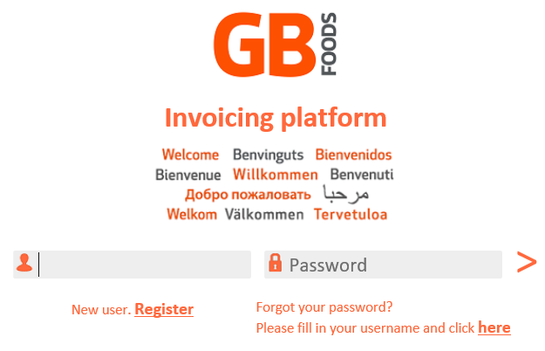
How do I register on the GBfoods Invoicing Platform?
Visit our website https://www.thegbfoods.com Supplier Area/Billing Platform
(Direct access URL: https://www.bsfactura.com/bsfzk6/home/login.zul?portal=gallinablancar)
Select New User
Enter your details and send
Registration confirmation will be sent to the email address you provided

Slide 4
What does “full company access” offer?
Company profile: Choose the type of platform access: Full access* can be activated and deactivated
Full access: (1) Send Invoice → send your invoices through the platform by any of the methods offered.
(2) Display Orders → display the status of orders approved by GBfoods.
(3) Display Invoice →Display the status of your invoice and payment date.
Deactivate full access: only option “(3) View Invoice” will be available.
*

Slide 5
I don't remember my password or it's blocked
You can reset your password from the “Forgot your password” option on the main login screen, filling in the user field and clicking “here”.
If your password is blocked, please contact APcontactcenter@thegbfoods.com to request that it be unblocked or call our Contact Centre at (+34) 933642533 (Monday, Wednesday, and Friday from 10 a.m. to 12 p.m.)

Slide 6
Where can I find the user guide?
In the User Guide section of the main menu you’ll find:
User Guide→ detailed information about how the platform works.
FAQS → frequently asked questions for a quick solution to your questions.

Slide 7
What formats can I use to issue invoices?
The Platform accepts the following invoice formats:
Invoicing Order
Send file.* (Facturae 3.2, TXT de Bsfactura ) Example file
GBfoods also offers an EDI invoice option (INVOIC D93 or D96). To manage the connection between ERPs, please contact AccPayable@thegbfoods.com

Slide 8
How can I search for a purchase order on the website?
Purchase Orders are available in the main menu section
once they are approved by the buyer. To search for an invoice:
Enter the purchase order number in the Order Number box.
Select the order dates (optional):
By default, the dates selected correspond to the last 15 months. Modify the dates to search for invoices older than 15 months.
Click on:
If the order is not found on the website, please contact APcontactcenter@thegbfoods.com

Slide 9
How can I bill a purchase order?
Send your invoice from the Invoicing/ Invoice PO section of the main menu in three simple steps.
Select the order(s).
Fill in the required fields on the invoice (marked with *).
Check the invoice details and send.
Please refer to the user guide for more detailed information.

Slide 10
How can I bill additional shipping charges on my invoice?
Select the order you want to invoice and add the shipping costs from the form as follows:
Select
Add the required information (*) for the additional shipping/fee.
Enter the same item number of the material or service to which the additional shipping or fee corresponds.

Slide 11
How can I cancel an incorrect invoice sent by the platform?
If you have sent an incorrect invoice via the platform, that is, the information sent does not correspond to the invoice posted to your accounting system, follow the steps below:
Contact GBfoods to request cancellation by email: APcontactcenter@thegbfoods.com
GBfoods will start the cancellation process.
Go to Dsiplay invoices.
The invoice will have a symbol next to it. Select it and check the “Request cancellation” option.
The status of the invoice will change to “Cancelled”.
Send the invoice again with the correct information following the usual system.

Slide 12
How can I issue a partial invoice (%) for an order?
To issue a partial invoice for an order:
Select the order from “invoice order”.
Modify the quantity, indicating the number of units invoiced:
Example: to invoice 30%, enter 0.30 in the quantity box.

Slide 13
Can I issue an invoice with “Closed” status?
You can send an invoice for an order with “invoiced” status, as long as:
The invoice sent was not for the total order amount.
You have confirmation from the buyer that the surcharge is correct.
Follow these steps to send the invoice:
Select the order with “Closed/Invoiced” status (you will be asked for confirmation to invoice).
Follow the usual steps by reviewing the amount and quantity to be billed in this case and then send.

Slide 14
How can I see the status of my invoices?
You will have access to the status of your invoices and the expected payment date from the Invoices/Display invoice section of the main menu.
Status legend:
Received – In process, pending posting.
Approved – Processed and pending payment on the due date indicated in the Payment date column.
Rejected – Not processed. See the details in the “Rejected” menu option.
Blocked – Payment pending approval due to a price or quantity discrepancy. Please contact the buyer.
Paid – Payment issued on the date indicated in the Payment date column.
Reverse factoring (*) – Reverse factoring issued to the bank with due date indicated in the Payment date column.

Slide 15
How do I update the company tax information on the platform?
You can update your tax information in the Supplier Profile section in the Suplier Tax Data section, with the exception of the Tax Identification Number, which cannot be changed in this section.
If your company Tax identification number has changed: Register as a new user on our platform.
The updated tax information will be reflected in the invoices sent after the change.

Slide 16
How do I activate the notifications feature from the platform?
To deactivate notifications of changes in invoice status, access and deactivate the following field:
Notify status changes
NOTE: Any notification sent from the platform will be sent to the email address indicated in User Data .

Slide 17
How do I issue invoices for logistics services?
Send your invoice from the Invoicing/ Logistic Services invoice section of the main menu.
This invoicing method is exclusively for logistics suppliers who do not have orders in the platform (*).
Manually enter the required information from the invoice form and send your invoice.
(*) Ask our Logistics Department if you should use this invoicing method.

