Slide 1
Invoicing Platform User Guide
September 2020

Slide 2
Índice
Register on the Platform
Vendor profile
Orders_ View/Invoice orders
Invoices_View Invoices
invoices_Rejected
Invoicing
Invoicing - Invoice order
Invoicing - Uploading files
Invoicing – Logistic Services Invoice
Definitions

Slide 3
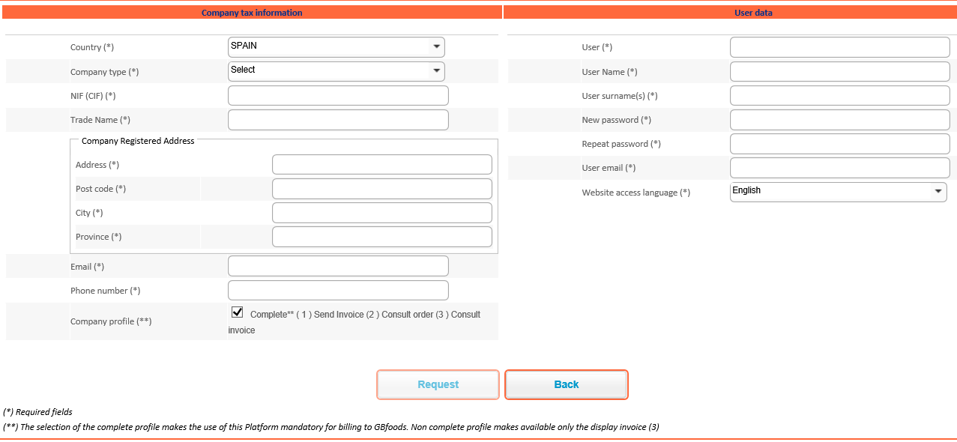
Register on the Platform
Register your company and user access in the platform.
Tax information of the company issuing the invoice
Company profile: Choose the type of access to the platform.
Full access* can be activated or deactivated. Both types of access offer invoice status display and payment date function.
Full access: (1) Send invoice (2) Display orders (3) Display invoice
Full access deactivated: (3) Display invoice
Platform user details
1
*
2
1
2
*

Slide 4
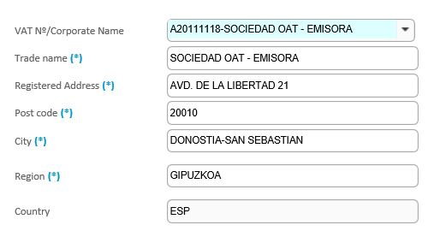
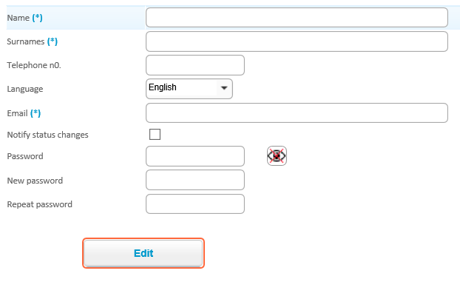
Vendor Profile
Update company and user details
*
1
2
*
All information can be changed except for the Tax Identification Number.
The company will need to register on the platform again to change the Tax ID
1
Email to receive notifications from the platform.
Activate/deactivate notifications of changes to invoice status
2

Slide 5
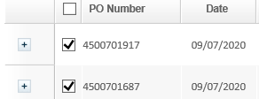
Orders_ View/Invoice orders
Check your orders (available once approved by the buyer)
Display order:
Enter the order number.
For searches by order date older than 15 months, change the date range.
Click on:
Check the order status in the columns.
If the order is not found on the website, please contact APcontactcenter@thegbfoods.com
Invoice order:
Select the order(s) you want to invoice.
Use the button to see the line item details and select line by line.
You can also select several orders to include in a single invoice.
You can also send invoices from the Invoicing menu.

Slide 6
Invoices_View Invoices
Check the status of your invoices and expected payment date
Invoice status that you can see in the Status column:
Received – In process, pending posting.
Approved – Processed and pending payment on the due date indicated in the Payment date column.
Rejected – Not processed. See the details in the “Rejected” menu option.
Blocked – Payment pending approval due to a price or quantity discrepancy. Please contact the buyer.
Paid – Payment issued on the date indicated in the Payment date column.
Reverse factoring (*) – Reverse factoring issued to the bank with due date indicated in the Payment date column.

Slide 7
See invoices_Rejected
See rejected invoices (sent with error)
The invoices in this section have been rejected by GBfoods.
See the reason for rejection in the "Rejection Type" column and the error details in the "No. Errors" column.
Correct the error from the Invoicing section and send again as usual.

Slide 8
Invoicing
Platform invoicing methods
Invoice order
Send invoice by selecting order(s). The invoice information will be automatically completed with the details from the order selected. The information can be modified.
Upload file
Send an invoice by uploading a file in any of the available formats (Factura-e 3.2 or .txt by BS Invoice available at the following link).
Logistic Services Invoice
Manually enter the invoice information.
Exclusive option for logistics suppliers who do not have an order in the platform.
 | Seller | Buyer | Invoice Header | Invoice Details
Invoice order | Automatic | Automatic | Automatic | Automatic
Upload file | Automatic | Automatic | Manual | Automatic
Logistic Invoice | Manual | Automatic | Manual | Manual

Slide 9
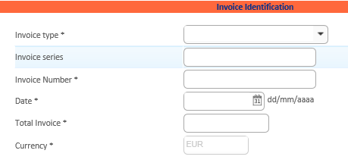
Invoicing - Invoice order
Issue an invoice in the "Invoice Order" mode
Select the order(s) you want to invoice and click on
Choose the type of invoice (Invoice or Corrected Invoice/Payment) and provide additional header information.
Change the order details, if necessary, and enter the VAT/tax rate.
Check that your invoice details are correct and click to complete the invoicing process.

Slide 10
Facturación – Facturar pedido
Incluir portes o gastos adicionales en factura
Una vez hayas seleccionado el pedido para facturar, desde el formulario podrás añadir lineas adicionales:
Selecciona
Añade los datos obligatorios (*) relativos al Porte/Gasto adicional. Indica misma posición de pedido y Nro. De material que aparece en el pedido.
Pulsa “enviar factura” una vez haya cargado y validado todos los datos a facturar

Slide 11
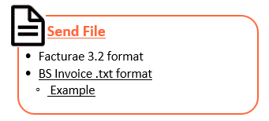
Invoicing - Uploading files
Send invoice in the “Upload File” mode
You have to use one of the available formats to send your invoice from "File Upload".
Select , choose the file and click
Once uploaded, you can check the file loading status from the menu.

Slide 12
Invoicing – Logistic Services Invoice
Issue invoice in “Logistic Services mode” (exclusively for logistic providers without an order in the platform).
Select the Purchasing company.
Choose the type of invoice (Invoice or Credit Note) and provide additional header information.
Manually enter the order confirmed by your contact at Gbfoods, who purchased the goods/service. Also fill in the required information from the form (*). Enter “10” in the “Order position” field and 400000 in the “Article no.” field.
Click once the invoice loads and check all the information on the invoice.

Slide 13
Definitions
Definition of concepts on the platform
Buyer – Company that receives the invoice.
Seller – Company that issues the invoice.
User – Person who accesses the platform.
Company details – Company that issues the invoice.
Company profile – Type of access activated on the platform.
Full profile – Access that makes it possible to check order status, invoice status, and send invoices through the platform.
Logistic services invoice – Delivery method for logistic providers who do not have an order in the platform.
Purchase Order number (PO) – Information that will be provided by the person who requests the services and/or products, and which includes the concept to invoice.
Order item – The order may contain several items/lines with various services and/or products.
Article number – GBfoods code corresponding to the material (product) or service included in the order.
Rejected invoices – Invoices that were not sent due to a formatting error. They can be found in the Invoices/Rejected section
Reverse factoring – Payment method that offers the possibility of advanced payment of your confirmed invoices by GBfoods

